Slide 1
Content- Based Image Retrieval
CS 512: Computer Vision
Fall ‘17
Presented by:
Charu Saxena
Vishal Kumar Bimal

Slide 2
Contents
Motivation
Proposed method
Features
Experiments
Conclusion

Slide 3
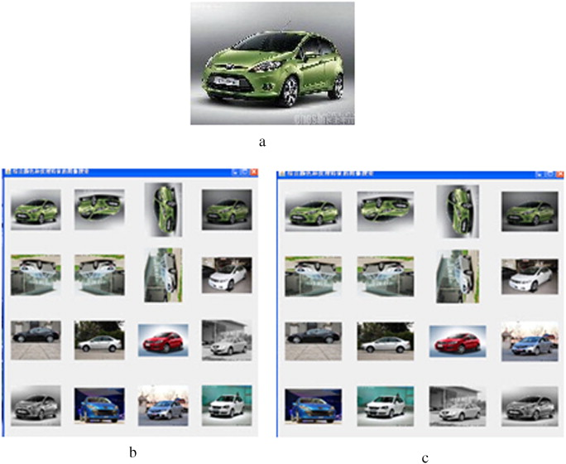
Motivation
A picture worth 60,000 words!
Storage and transmission has become troublesome with more images
The traditional way of an annotated image using text, lacks the automatic and effective description of the image.
Needs a system that would understand and interpret the content of managed images

Slide 4
What is CBIR?
Content-based image retrieval, a technique which uses visual contents to search images from large scale image databases according to user's' interests, has been an active research area since the 1990s
Help in finding you the images you want.
Applications include: Geographical information and remote sensing systems, Medical diagnosis, Military, IBM’s QBIC.

Slide 5
Proposed method

Slide 6
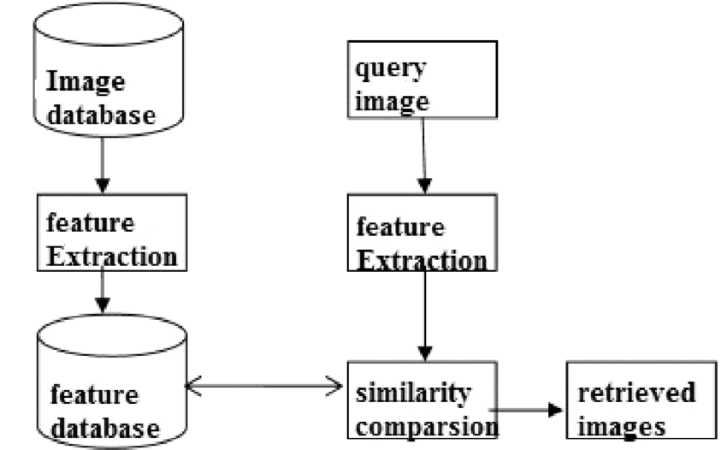
Proposed Method:
Features are extracted for all the images and saved to database.
A query image is provided to system to retrieve similar image present in the database.
Feature extraction is done for this query image .
Feature similarity is done for the query image and all the images present in the database.
List of similar images are displayed.

Slide 7
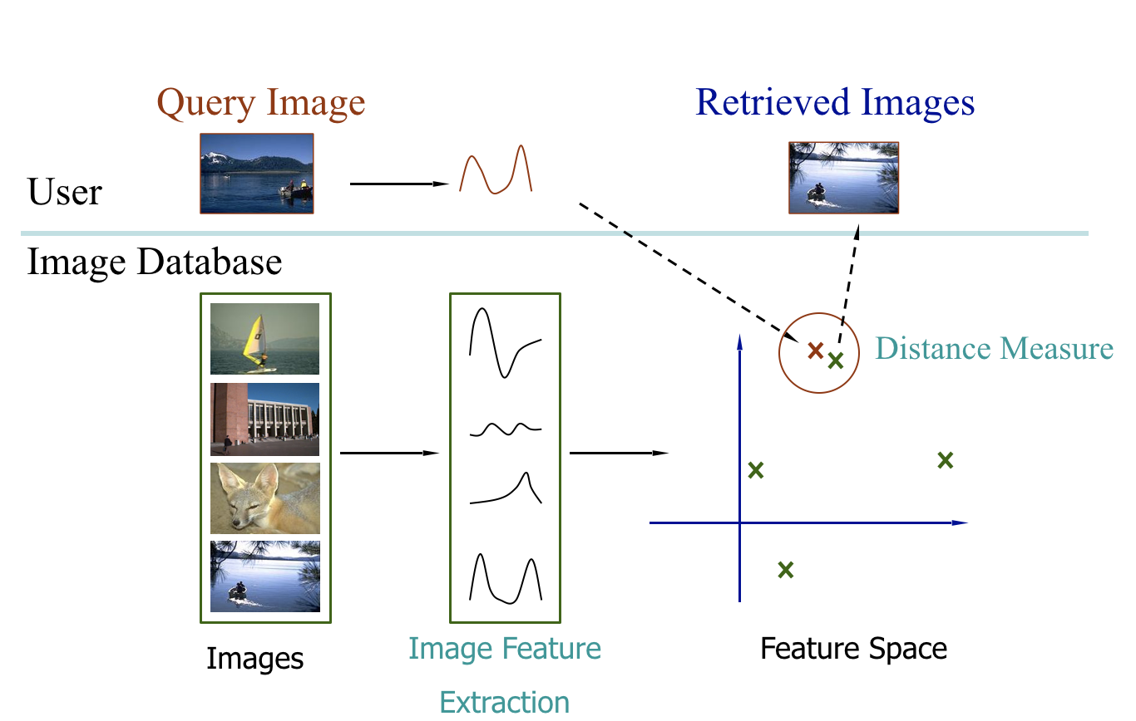

Slide 8
Features

Slide 9

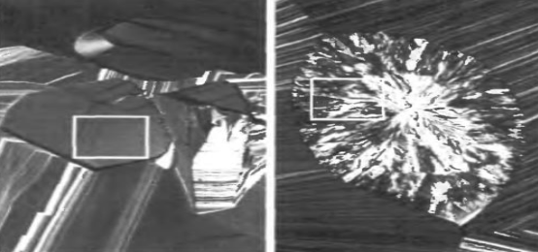
Features Extracted
For this project we used two features and calculated the description for a image:
Color-Based Histograms
Texture Based

Slide 10
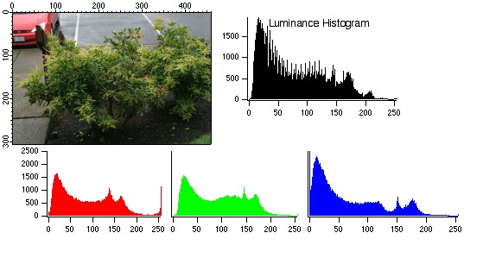
Color-based
Color similarity is achieved by computing a color histogram for each image that identifies the proportion of pixels within an image holding specific values (that humans express as colors)
. Color searched will usually involve comparing histograms.
It does not depend on image size and orientation.Here two approaches were used :
Global color feature
Local color feature

Slide 11

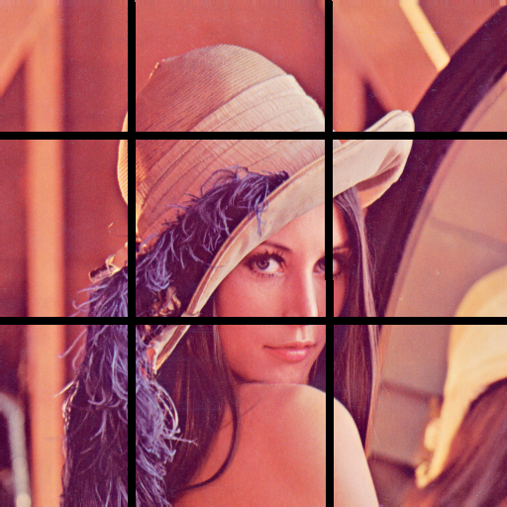
GLOBAL-Feature
LOCAL-Feature

Slide 12
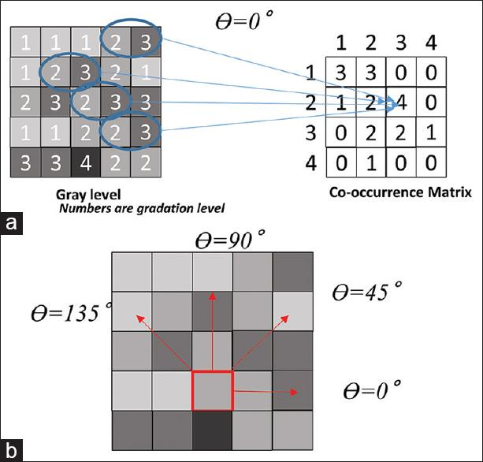
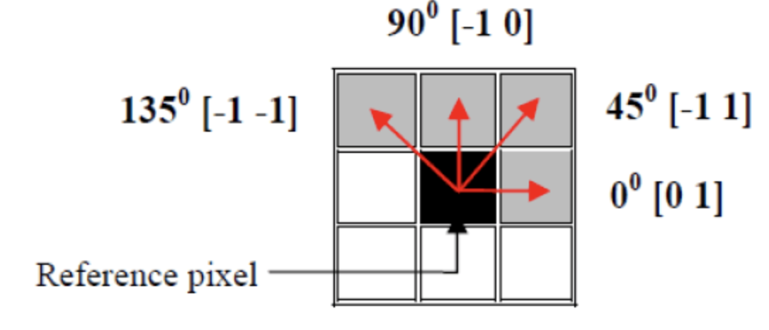
Texture Feature
Texture refers to visual patterns with properties.
A co-occurrence matrix is adopted to extract texture features as
it requires less computation and
has a faster feature extraction speed. Moreover,
the feature vector dimensions are also smaller.
we determine horizontal and vertical space domain and direction and distance d is determined here directions used are: 0°, 45°, 90°, 135° and distance used is 1.
we calculate four co-occurrence matrices in four directions. The parameters which are here taken into account are
moment of inertia,
Angular Second Moment
Correlation and
Homogenity

Slide 13
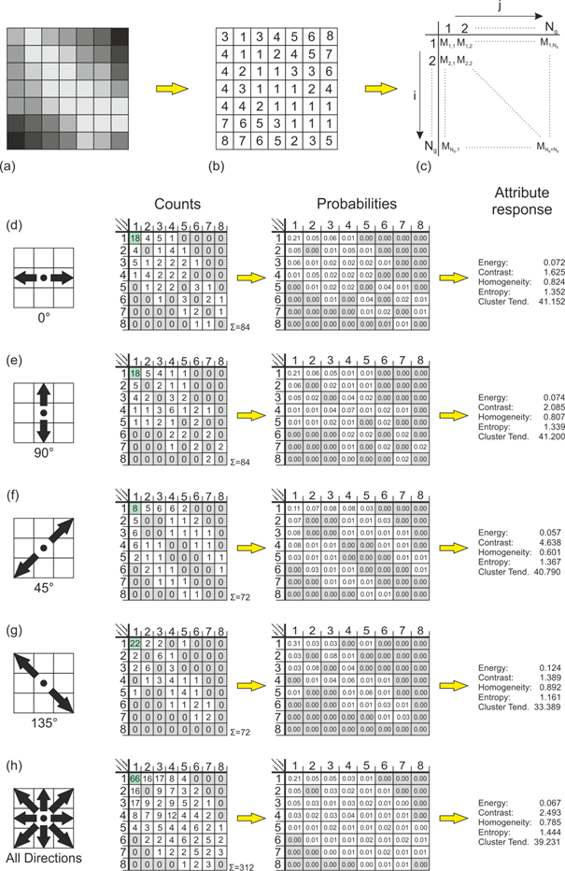

Slide 14
Experiments

Slide 15
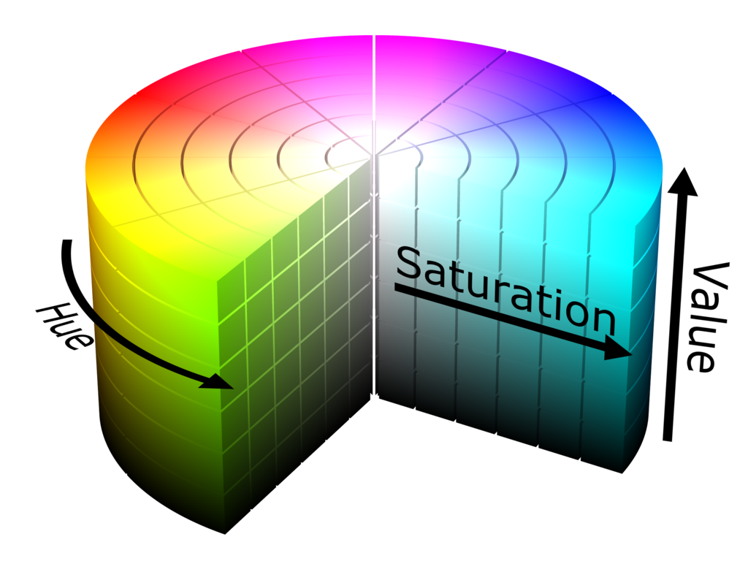
Experiments
For color-based features first images were loaded to HSV format and features were calculated for both global and local.
Texture feature was calculated all directions for all features with all four parameters
For testing for all images , we made three databases containing:
global color feature
Local color feature
Texture feature

Slide 16
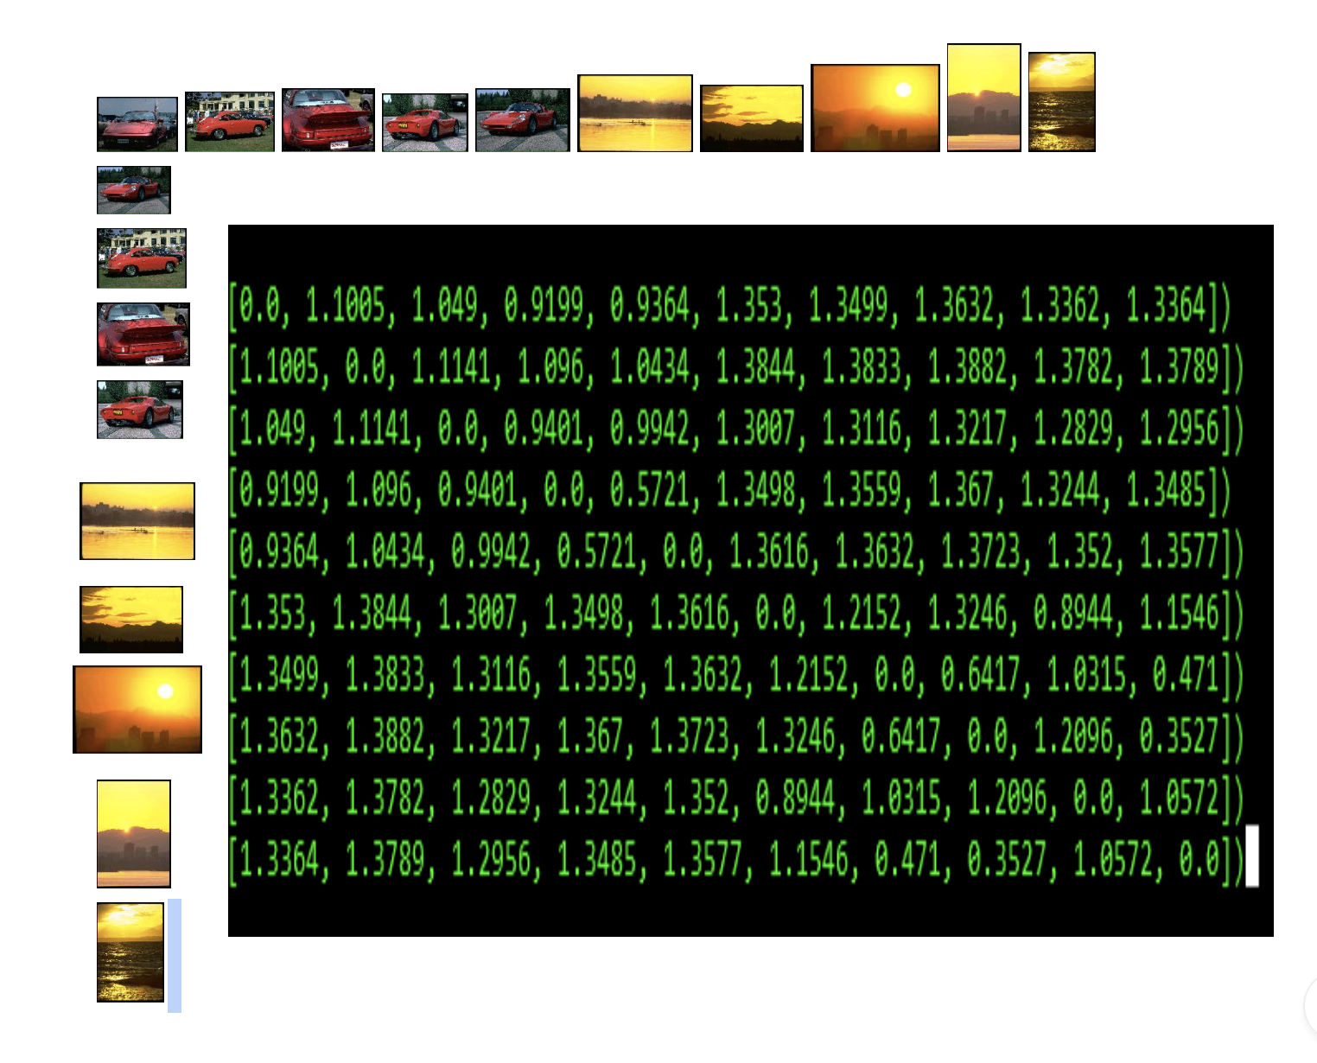
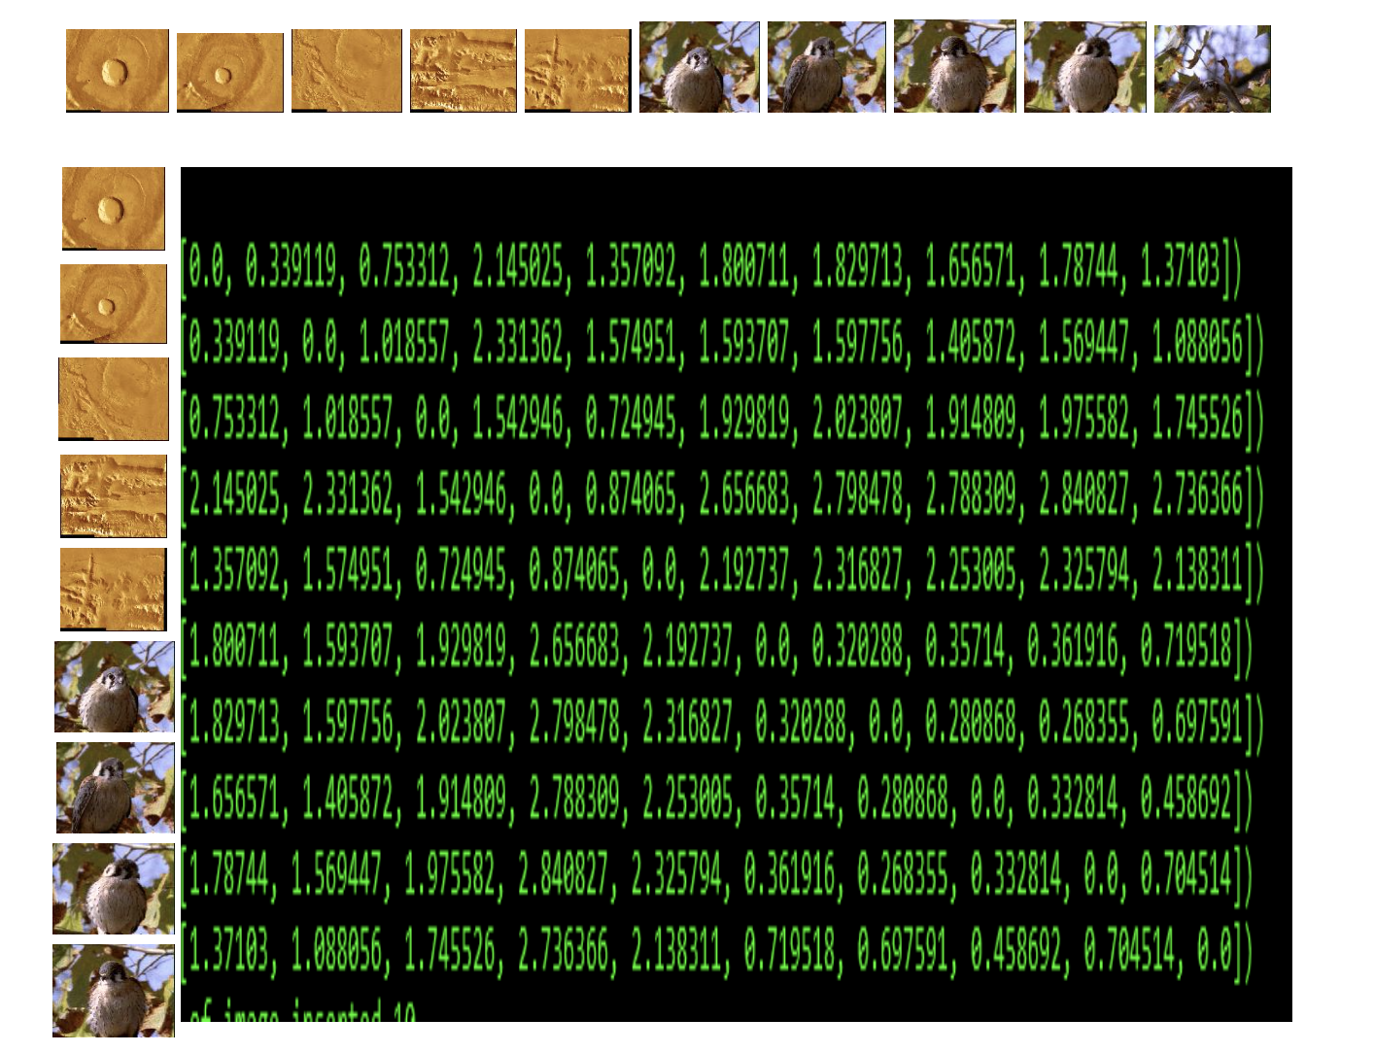
Experiments/Results
Following experiment results are for feature extraction:
For global color histogram feature For texture feature

Slide 17
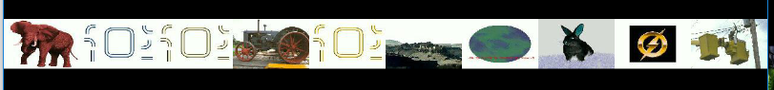
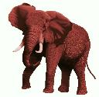
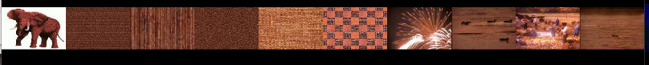
Experiments/Results
Following shows results for the global-color histogram and local-color histogram

Slide 18
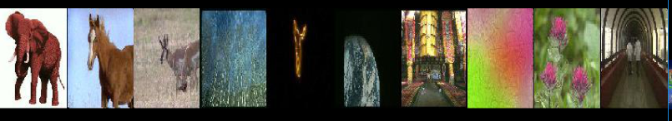

Experiments/Results
Following shows results for the showing texture feature and final result combining both local-color
histogram and texture.

Slide 19
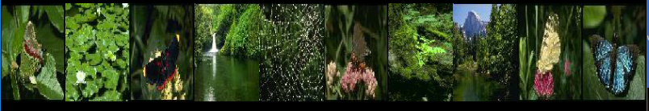
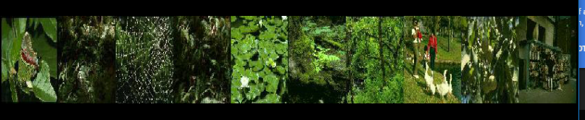
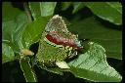
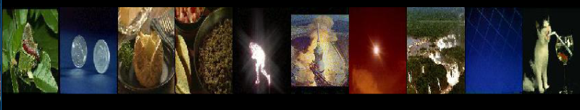
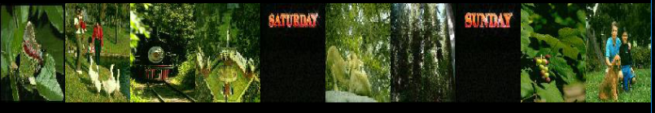
Experiment/Results

Slide 20
Limitations
We do not yet have a universally acceptable algorithmic means of characterizing human vision, more specifically in the context of image understanding.
Hence it is not surprising to see continuing efforts towards it, either building up on prior work or exploring novel directions.

Slide 21
Conclusion
The paper and project explored the low-level features of color and texture extraction for CBIR. After comparing the two color histogram features as well as comparing color and texture features, we implemented a CBIR system using color and texture fused features.
Similar images can be retrieved quickly and accurately by inputting an image. More low-level features such as shape and spatial location features etc. will be fused to make the system more robust in the future. The image feature matching method and semantic based image retrieval are the other two important aspects for the CBIR system.

Slide 22
References:
https://en.wikipedia.org/wiki/Content-based_image_retrieval
Paper link:
https://ac.els-cdn.com/S0895717710005352/1-s2.0-S0895717710005352-main.pdf?_tid=687db446-ba76-11e7-9290-00000aacb362&acdnat=1509040518_23e1195c95f4fc6dddcf5687dfaebba2
Data link: http://imagedatabase.cs.washington.edu/groundtruth/
https://dsp.stackexchange.com/questions/2687/why-do-we-use-the-hsv-colour-space-so-often-in-vision-and-image-processing
http://scientific-journals.org/journalofsystemsandsoftware/archive/vol2no1/vol2no1_1.pdf
https://pdfs.semanticscholar.org/ddaa/6e0b3d228d5389d060d7fefffaaa0db98864.pdf
http://facweb.cs.depaul.edu/research/techreports/tr06-010.pdf

Slide 23
Thank you!
Any Question?

